Slide 1
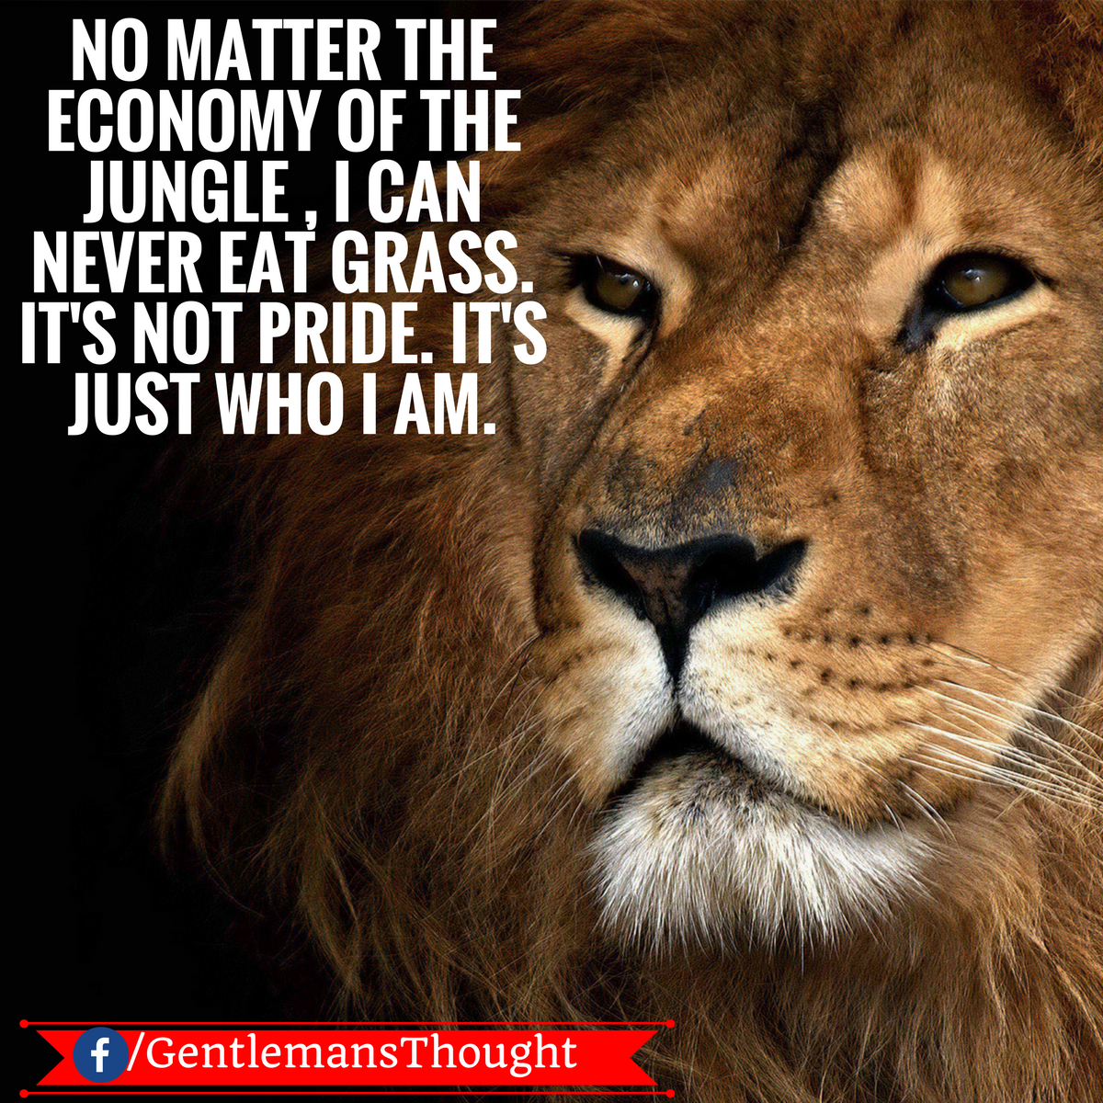

Slide 2
Lecture 2
Parts of Speech (Cont)

Slide 3
Objectives
Practicing the usage and errors based on
Adjective
Preposition
Adverb
Conjunction and interjection

Slide 4
Adjectives ending in -ing, -ed
Do you know the difference between bored and boring?
Look at these examples to see how adjectives ending in -ed and -ing are used.
I was really bored in that presentation. That was a really boring presentation.

Slide 5
Adjectives ending in -ing, -ed
An adjective that ends in -ing is used to describe: the characteristic of a person, a thing or a situation.
An adjective that ends in -ed is used to describe: a feeling or an emotion. It is used to describe a temporary thing.

Slide 6
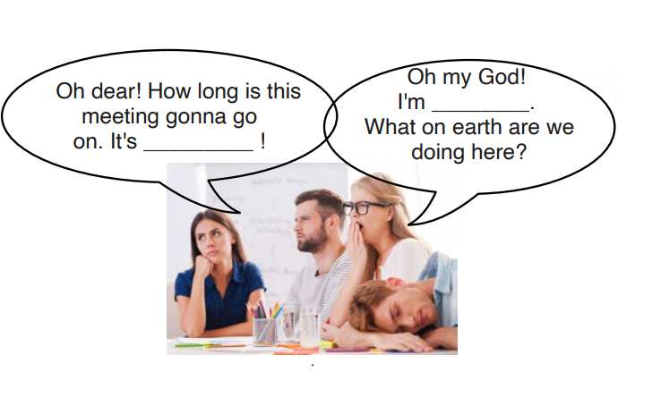
Test yourself!
Fill the blanks with adjectives ending with –ing or –ed
Adjective - bore

Slide 7
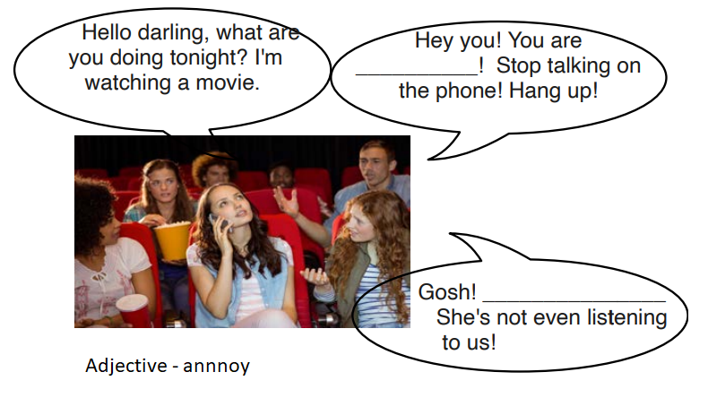

Slide 8
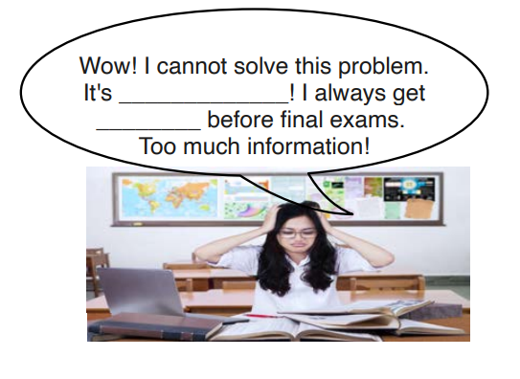
Adjective - confuse

Slide 9
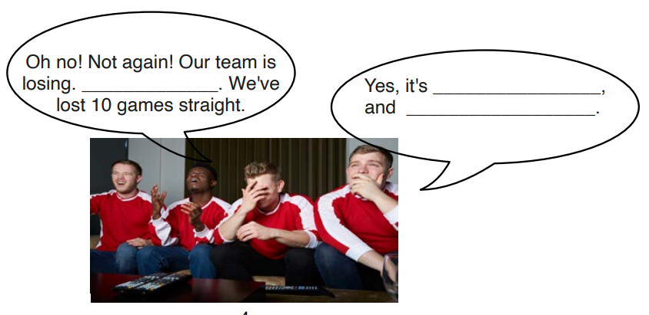
Adjective – embarrass, disappoint

Slide 10
Difference in Adjectives and Adverbs
Adjectives describe nouns or pronouns
Adjective example: “The dog is fast”
Here “Fast” is an adjective because it is describing a
noun (dog).
Adverbs describe verbs
Adverb example: “The dog runs fast”
Here “Fast” is an adverb because it is describing a verb
(runs).

Slide 11
Adverbs with the Verb
Placement | Example
before the verb | Happily she ran over the sand dunes. Tearfully, he told his brother the whole story.
after the verb | She ran happily over the sand dunes. He was telling the whole story tearfully to his brother.
between the auxiliary and the main verb. | He was happily running about over the sand dunes. He was tearfully telling the whole story to his brother.

Slide 12
Read the sentence to find out if there is any error in it. The error, if any, will be in one part of the sentence. The number of that part will be the answer. If there is no error, then the answer is (E). Ignore errors of punctuations, if any.

Slide 13
1. The driver tried his best (A)/ to avert the accident by (B)/ bringing the car (C)/ to a suddenly stop (D)/ No error (E)
Answer Explanation: The error is in part D as the adjective sudden needs to be used in place of suddenly.

Slide 14
2. The technician reminded (A)/ them to have a thoroughly (B)/ cleaning of the (C)/ machine after each use (D)/ No Error (E)
Answer Explanation: The error is in part B as the adjective through needs to be used in place of thoroughly

Slide 15
3. Watch (A)/how careful (B)/ the sparrow knits (C)/the straws to form a nest. (D)/ No error (E)
Answer Explanation: Here in this sentence ‘careful’ is an adjective which should be replaced by ‘carefully’ which is an adverb to make the sentence grammatically correct. So option B is the correct answer.

Slide 16
4. The children (A)/ have been practicing (B)/ hardly for their (3)/ school Sports Day and so they deserve the first prize (D)/ No Error(E)
Answer Explanation: The error is in option C, as the adverb required here is 'hard' meaning practicing 'sincerely' or 'a lot', 'hardly' means 'not at all' or 'very little'.

Slide 17
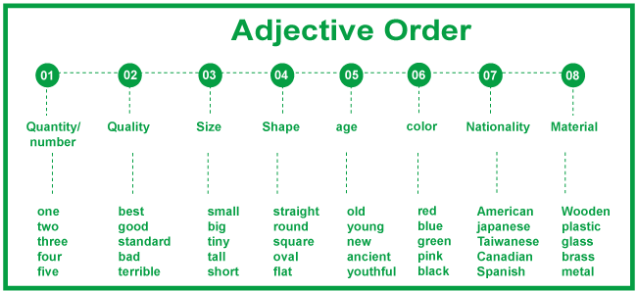
Word order

Slide 18
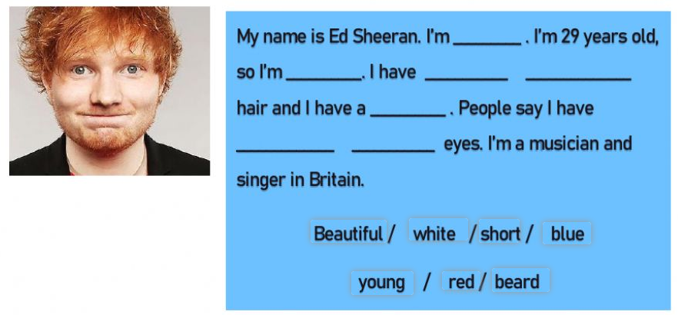
Read & complete the descriptions. Use the correct words from the box

Slide 19
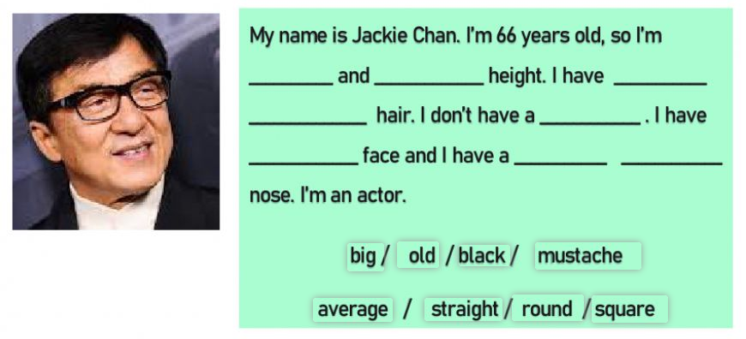
Read & complete the descriptions. Use the correct words from the box

Slide 20
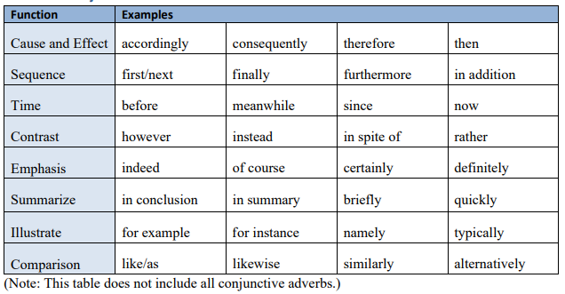
Adverbial and Compound Conjunctions

Slide 21
Choose the best answer to complete the sentence.
You need to put more effort into your work; _______, you
won’t get a passing grade.
Moreover
Otherwise
Unless
Instead

Slide 22
Adjectives+Prepositions
Complete each question with the correct preposition.
What are you interested ....................?
Do you get excited .................... going on holiday?
What is your country famous ....................?
What school subjects were you keen .................... as a child?
What do you get angry .................... people about?

Slide 23
Verb+Prepositions
All the students will work ___ a collaborative environment.
They need to concentrate ___ their studies.
They will be placed ___ a range of community settings.
We examined the scientific basis ___ dental practice.
This degree appeals to students who are interested ___ working in the new fields and occupations created by digitisation

Slide 24
Thank you

